Slide 1
Professional Device Care
Joris Vanhee – HPE/ARUBA

Slide 6
Source: Hardware.info

Slide 7
Do’s & Don’ts
Make sure batteries are partially charged when storing
(40-50% ideally)
Don’t charge batteries in freezing temperatures
Don’t use a damaged/swollen battery
Nice to have
Keep battery percentage between +-20-80%
Avoid fast charging/high temperatures
Avoid high moisture environments
Valid for Lithium-Ion batteries

Slide 8
Cables?

Slide 9
Source: Microsoft

Slide 11
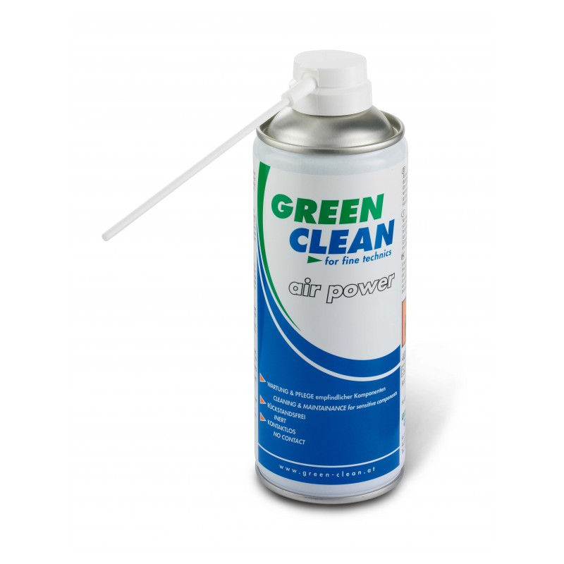
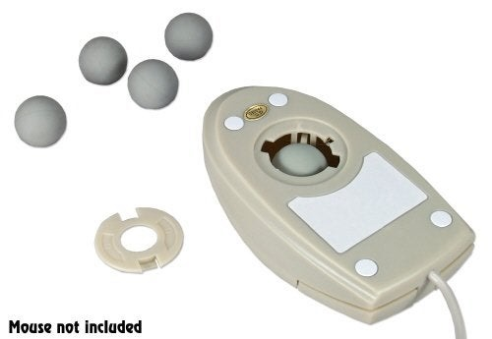

Slide 12
Sufficient storage
Avoid unused apps
Keep system up-to-date
Back-up

Slide 14
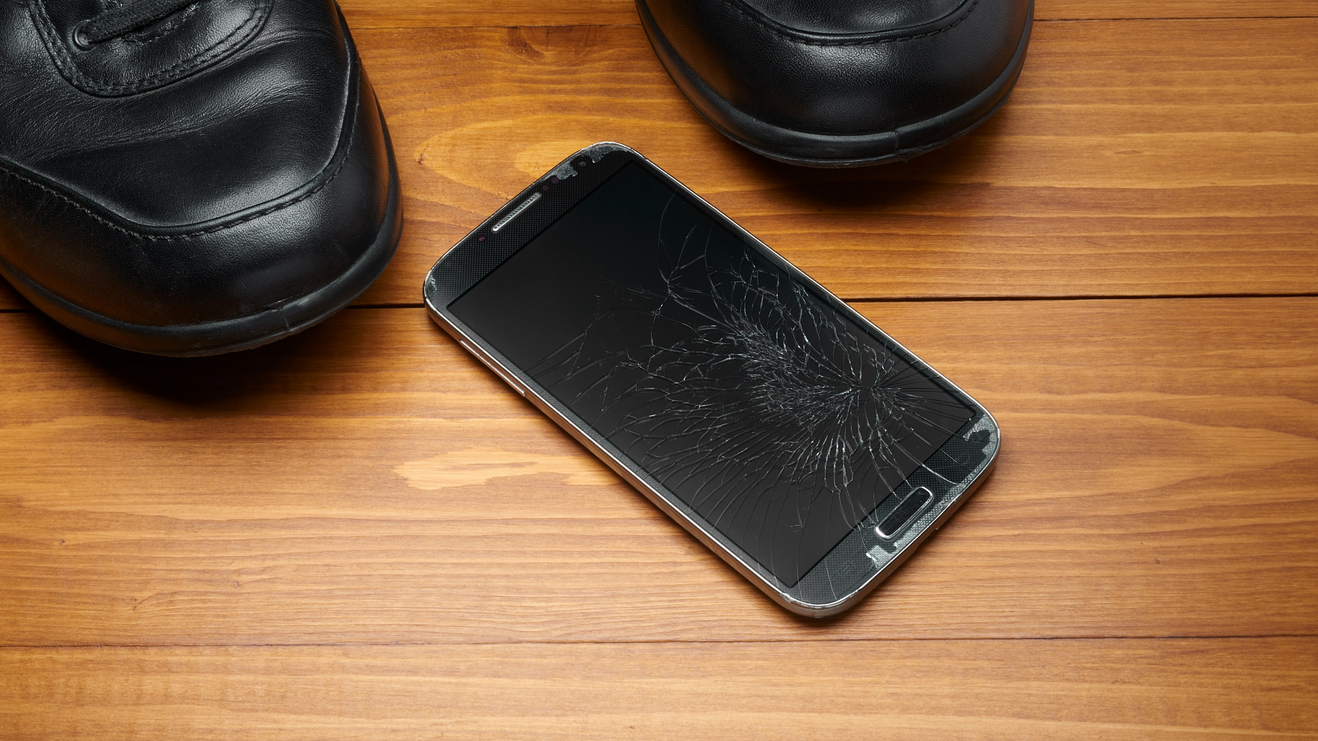
Don’t go breaking my heart

Slide 15
Any Questions?

